Slide 1
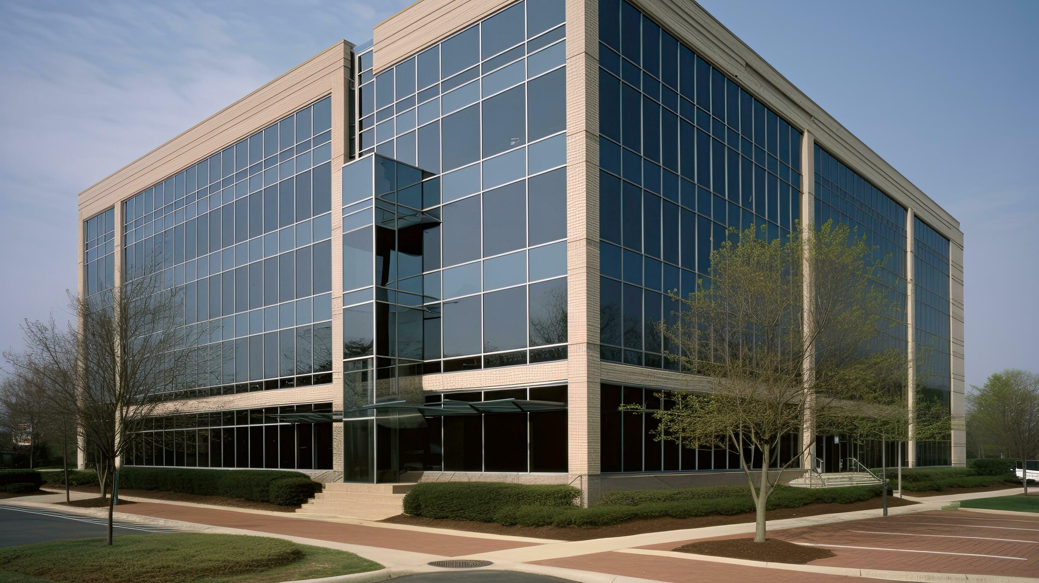
GENTECH

Slide 2
PROJECT CHARTER
PROBLEM STATEMENT:
Gentech, a multinational company with an annual revenue of $60 Billion, has cumbersome and inefficient practices. This has led to 18% loss in revenue in the last two years (2019-2020).
OBJECTIVE:
Reduce the cycle time of proposal creation process worldwide by 15% by optimizing the supply chain to be cost effective and flexible to customer needs to increase market share and profitability.
OPERATIONAL METRICS:
Cycle Time | Request Processing Time | Configuration Review Time
Pricing Approval Time | Defect Proposals

Slide 3
PROJECT CHARTER
SCOPE:
STAKEHOLDERS
GEOGRAPHY
DATA
Elliot Smith(CEO)
Grace Monroe(VP, Supply chain)
Jeff Hugh(LSS Black Belt)
Clients
Sellers
Bid Support Specialists
Proposal Support Managers
Price Specialists
Product Design Team
Brand Managers
North America
South America
Europe
Middle East
Africa
Asia Pacific
Japan
Manilla(US sellers engage with BSS)
Bid sizes
Geography
Sellers
Brands
Seller Feedback
BSS Feedback
Year
Month

Slide 4
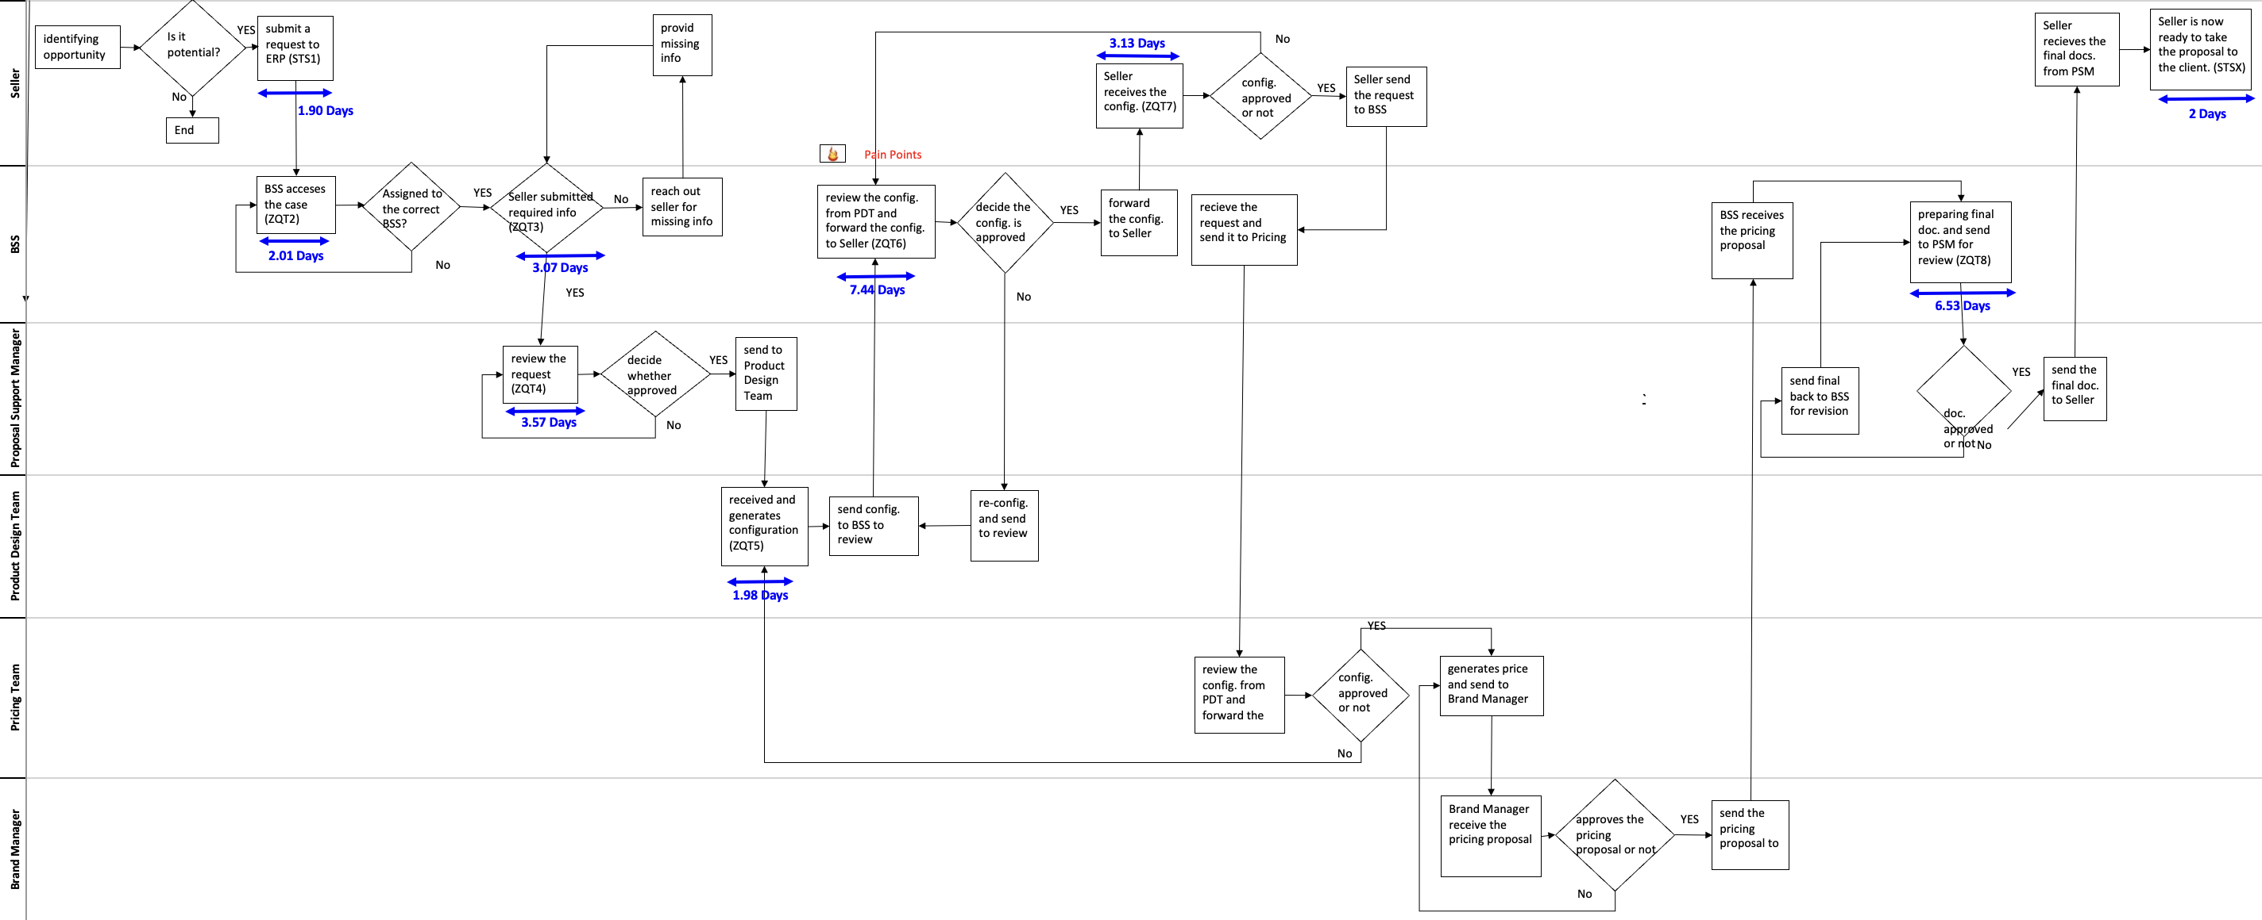
PROCESS MAP

Slide 5
BASELINE CONSIDERATIONS
Brand and Geography wise cycle time shows that NA has the largest difference between max. and min. CT in 4 out of 5 regions.

Slide 6
CURRENT SCENARIO
Based on the current service level agreement the DPMO is 281049.6
Gentech is functioning at a sigma level of 0.5797

Slide 7

The Pareto Chart indicates that ZQT6 represents 23.5% of the average cycle time. We can cut the cycle time by 6.5% if we can lower the ZQT6 Average by two days.

Slide 8
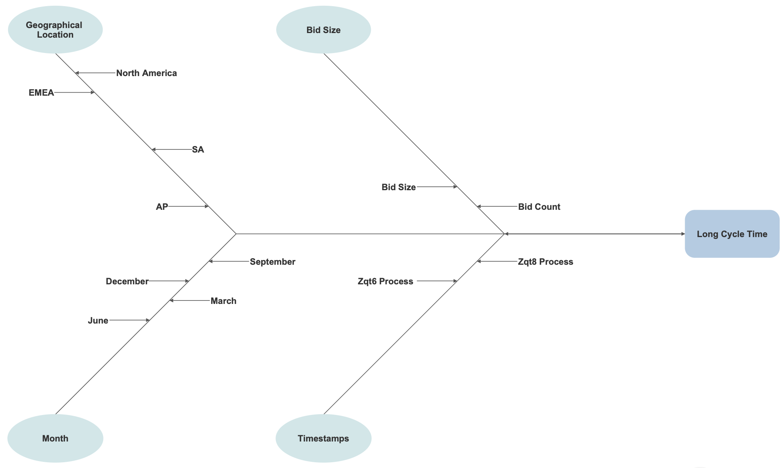
The Fishbone diagram shows the cause-and-effect relation between various attributes and delayed cycle time.

Slide 9

BRANDS GEOGRAPHIES

Slide 10
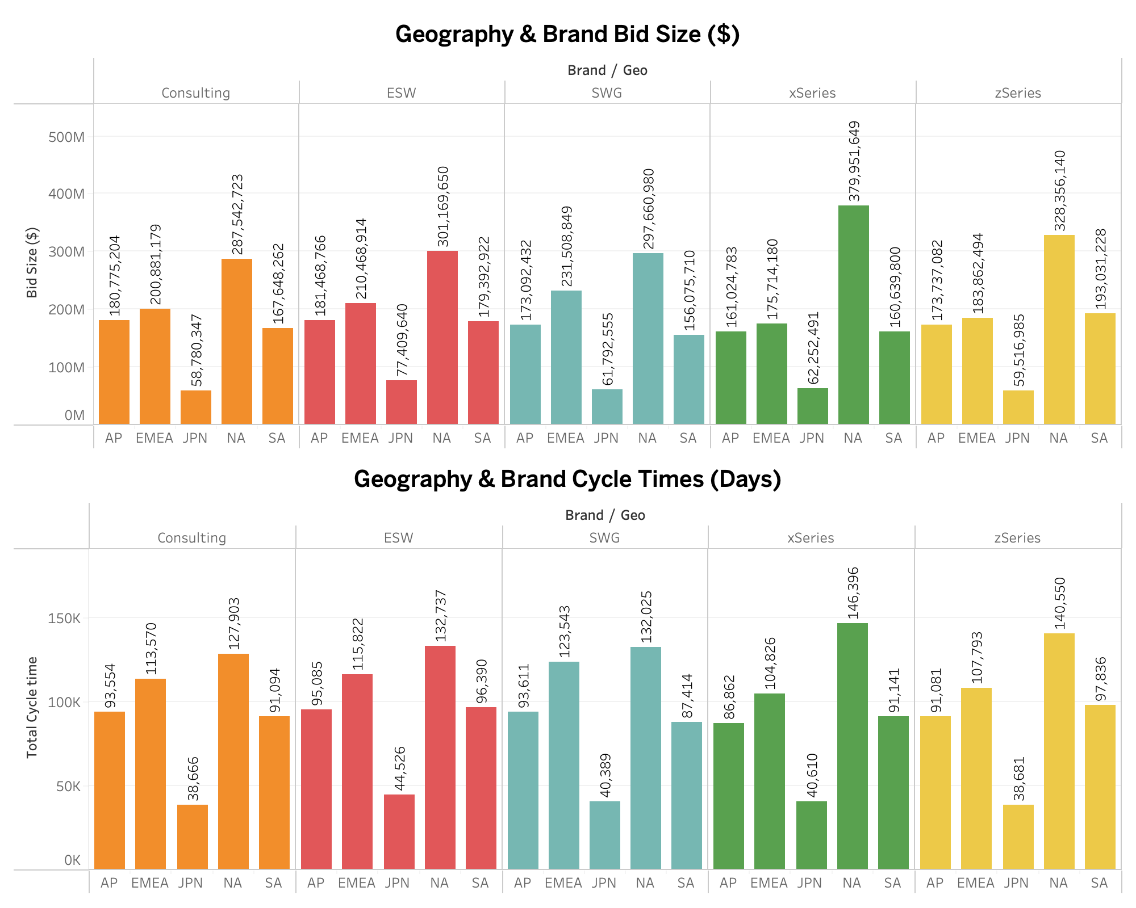
Notes:
The dashboard clearly indicates a consistent correlation between Bid Size and Total Cycle Time. This pattern is observed across all brands in various geographic regions, implying that no brand is demonstrating superior performance compared to its counterparts in any given location. This is because Total Cycle Time consistently rises with increasing Bid Size across the board.

Slide 12
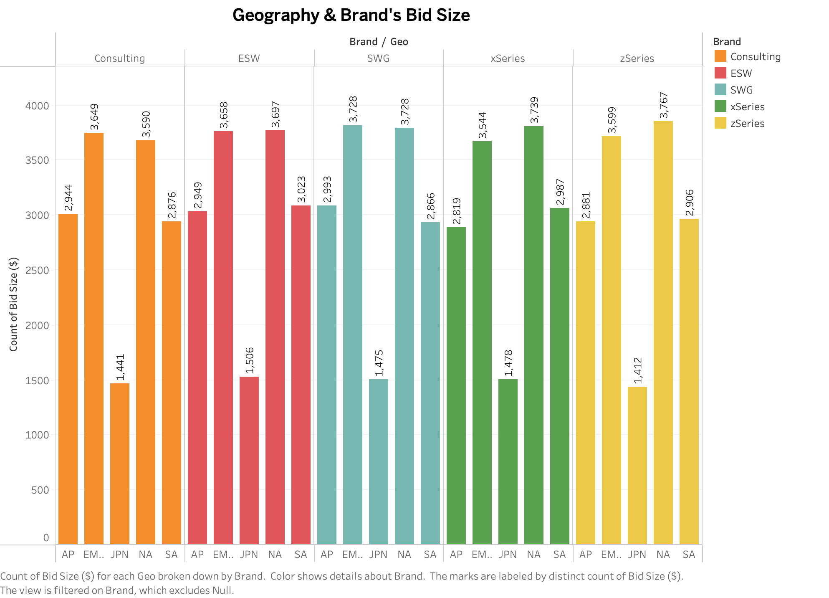

Slide 13
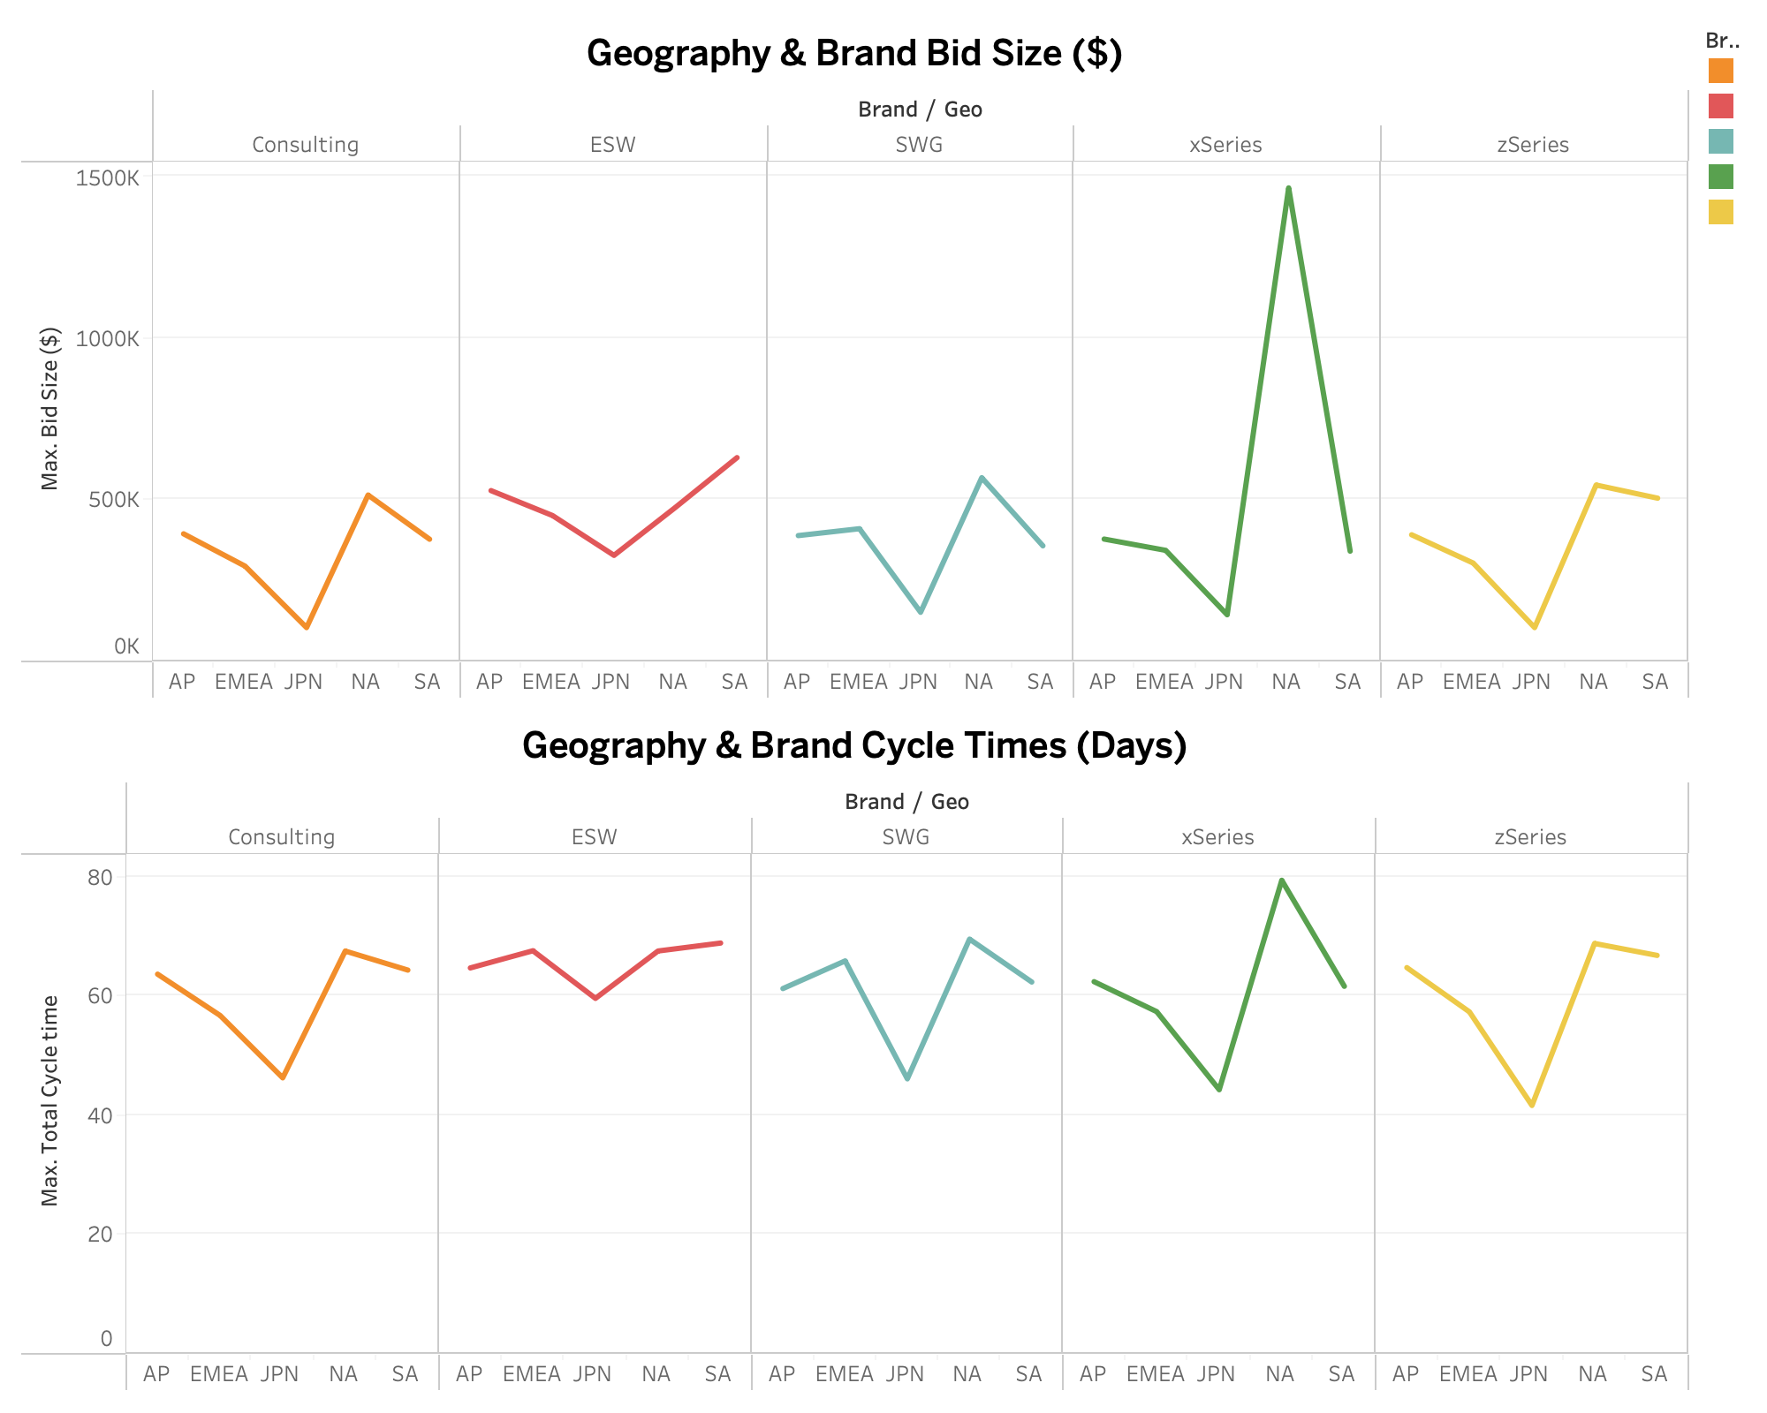
BID SIZE vs. CYCLE TIME

Slide 14

TIME-STAMP ANALYSIS

Slide 15
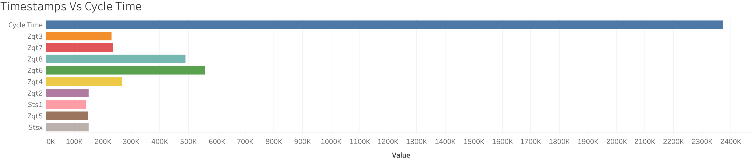
ZQT6 and ZQT8 are major contributors to the total cycle time.
Focusing on these specific processes may improve the cycle time.

Slide 16
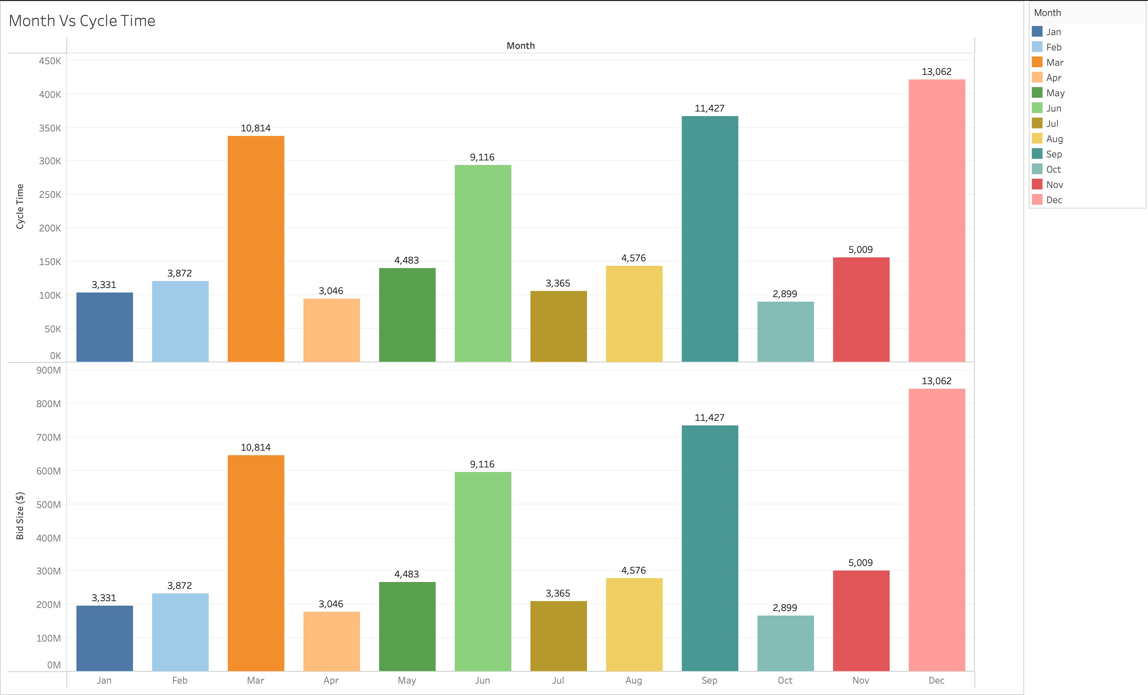
Seasonality in bid size is also reflected in the seasonality of the average cycle time

Slide 17
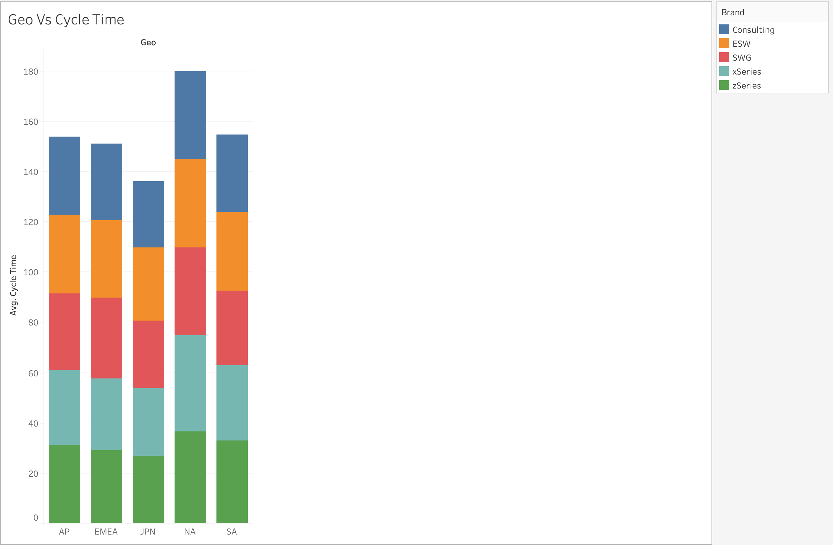
North America significantly contributes to the highest average cycle time.
Relatively uniform distribution of cycle time among brands.
Brand itself may not be a primary factor influencing cycle time.

Slide 18

SELLER vs. BSS

Slide 19
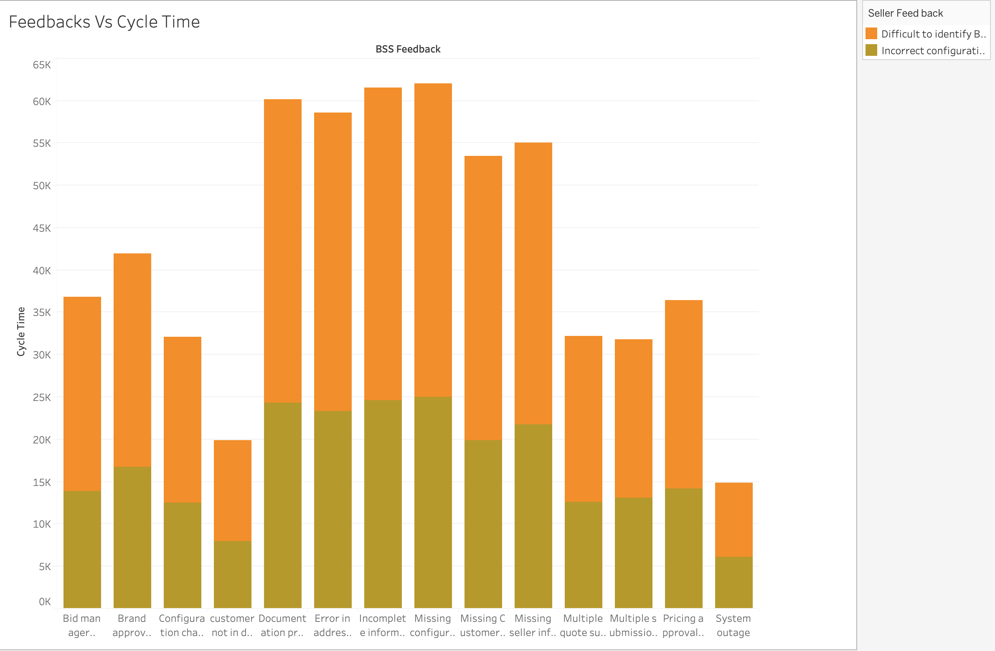
Identifying BSS agents and incorrect configurations are major contributors.
The BSS feedback underscores the importance of addressing these crucial issues, which significantly impact cycle time.

Slide 20
BSS vs. CYCLETIME

Slide 21
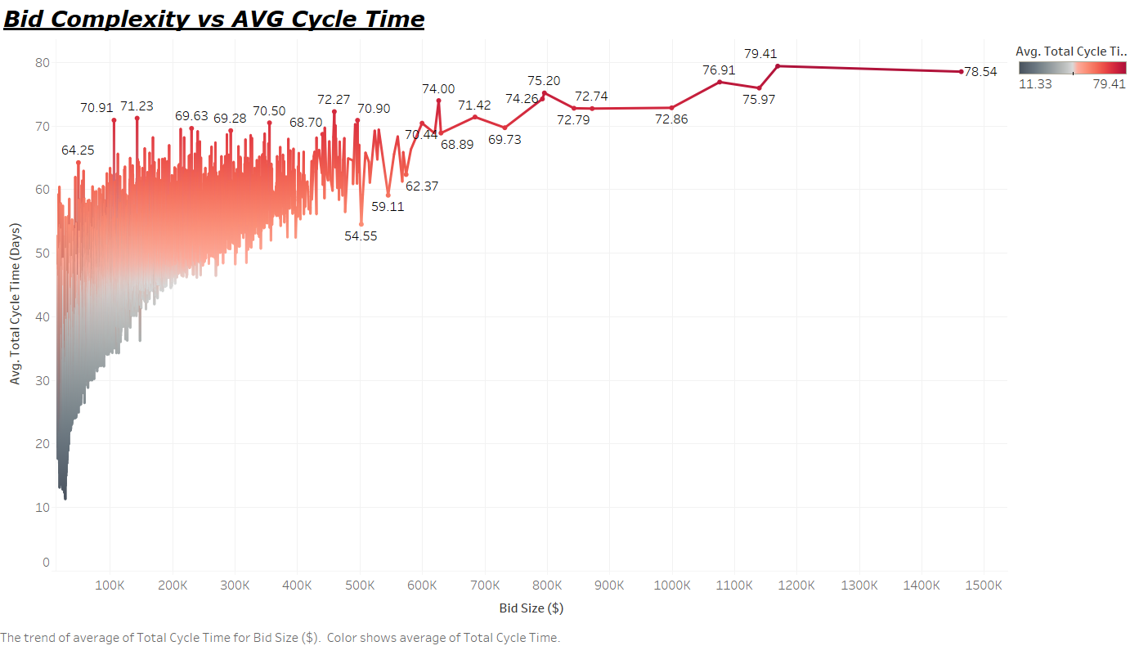
Complex bids have higher cycle time, implying a positive correlation.

Slide 22
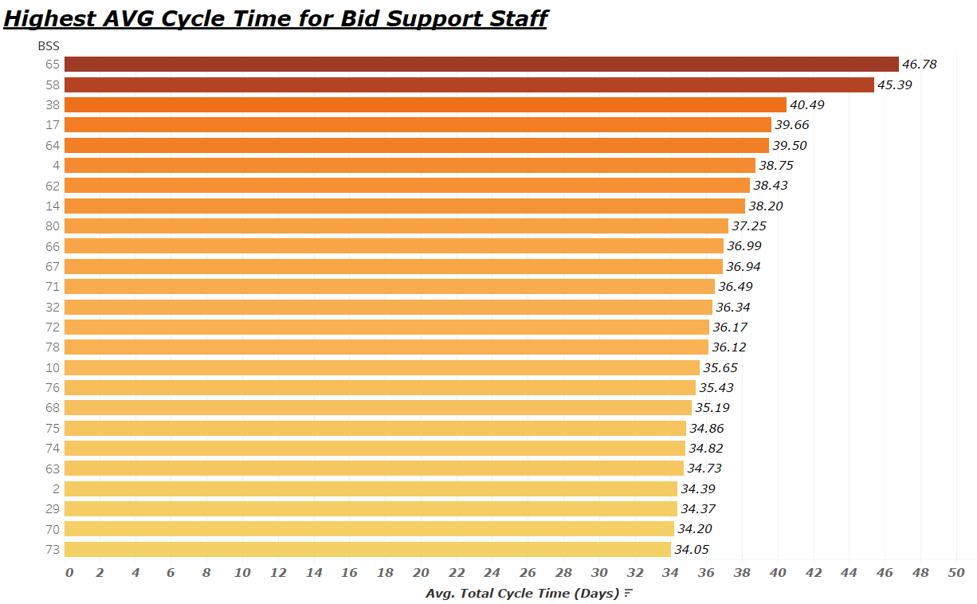
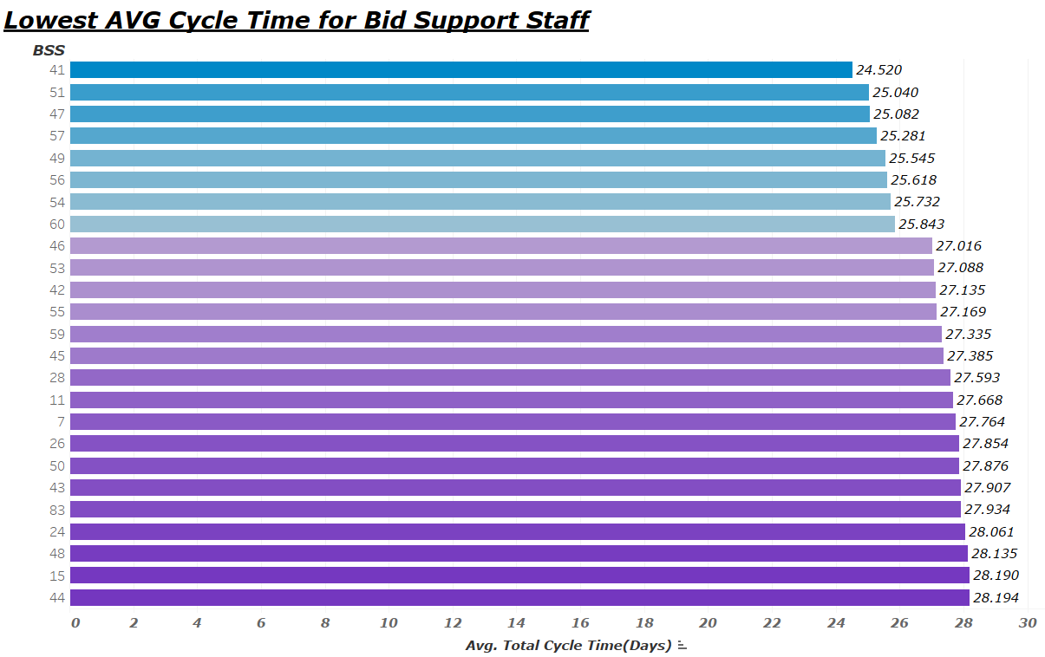
Best/worst BSS performance based on cycle time.
Lower average cycle time implies better performance.
Left graph shows the BSS that need focus to improve overall cycle time.

Slide 23
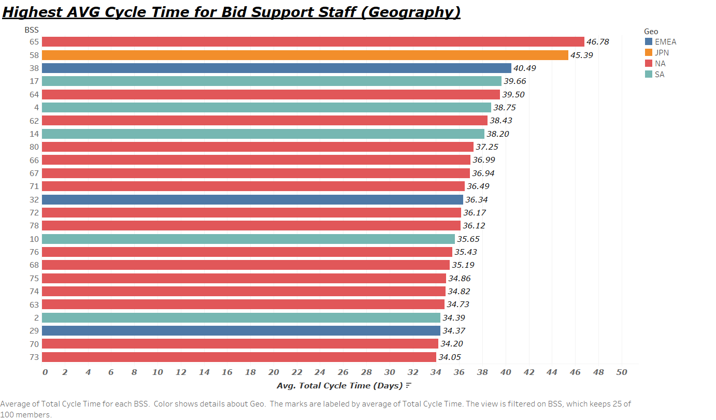
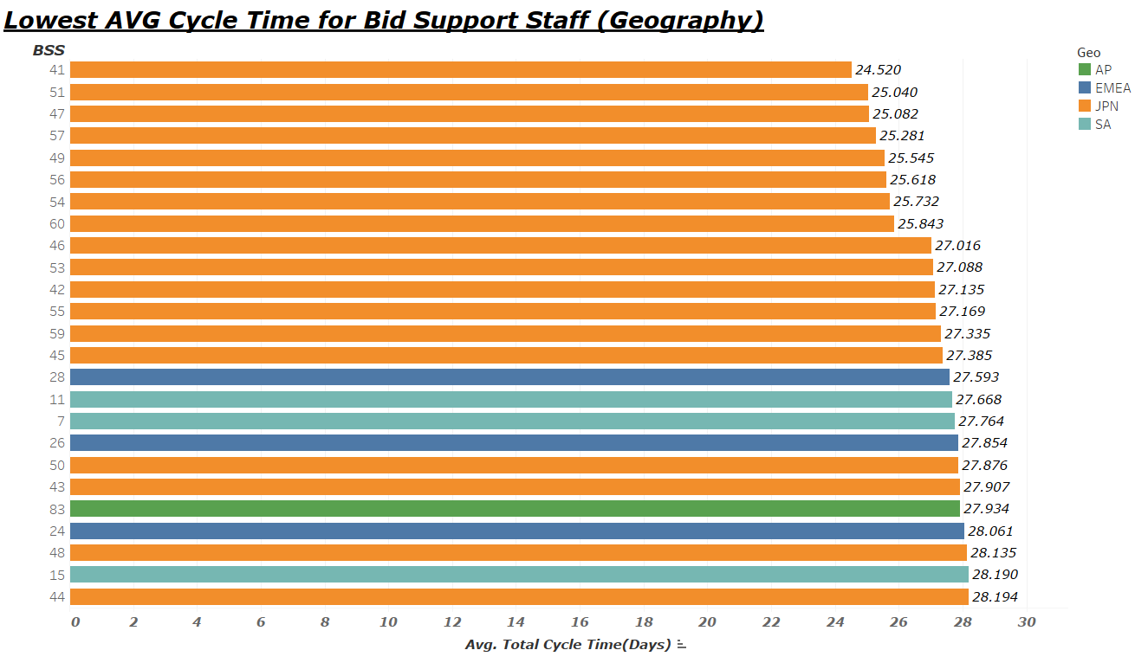
NA has most of underperforming BSS, and JPN has most of the best.
BSS skill does not necessarily have a bearing on cycle time.
Best practices from JPN can be used to help NA improve cycle time.

Slide 24
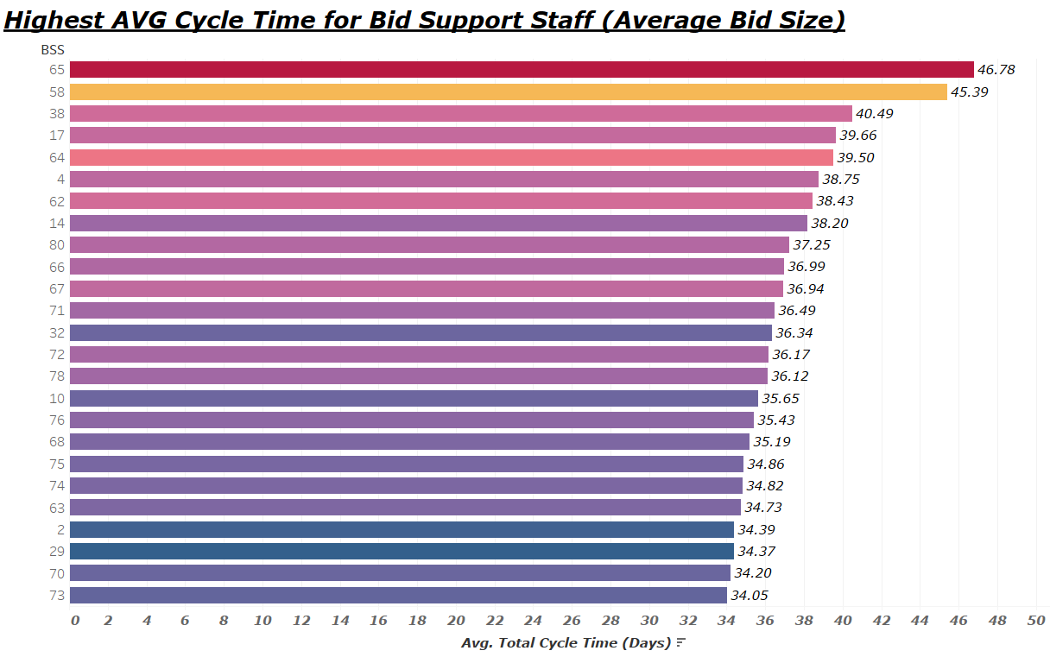
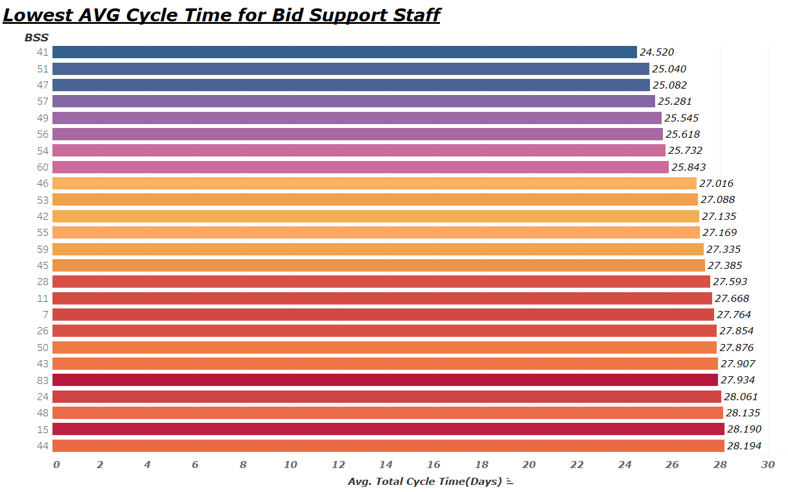
Best/worst performing BSS based on bid size.
Positive correlation between bid complexity and average cycle time.
BSS skills aren’t necessarily to blame.

Slide 25
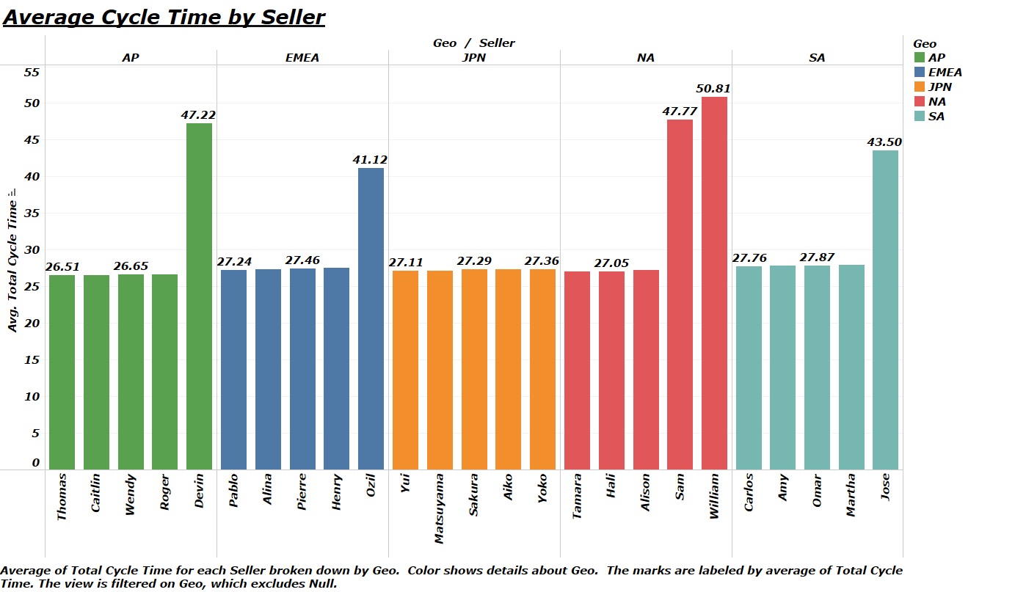
Seller performance based on average cycle time.
All regions except JPN have underperforming sellers.
Focus to improve can be on these respective sellers.

Slide 26

RECOMMENDATIONS
Streamlined, simple proposals to reduce process complexity.
Streamlined approval hierarchy.
Dynamic work allocation – assign the correct BSS the first time
Establish/ reinforce continuous process improvement culture

Slide 27
CONTROL PLAN
Assigning the correct BSS the first time based on bid complexity.
Include consequences for failing time commitment agreed on service level agreement.
Real-time monitoring using ticket management systems – to track the cycle times and its delays.

Slide 28
THANK YOU!

